Slide 1

Surface catalysis
王涛、陈兆营、潘圆圆、维丽色、赵辉、张银峰、付雷、程玉田、黄越飞
20131112

Slide 2
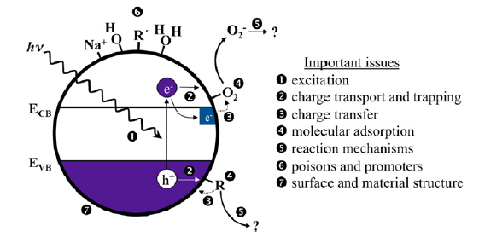
Theory
TiO₂ photocatalysis

Slide 3
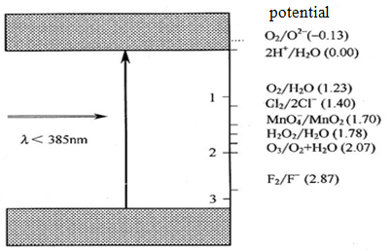
The comparison of electrode potential between TiO₂ electron - hole pairs electric potential（3.0ev） and oxidation - reduction pairs potential

Slide 4
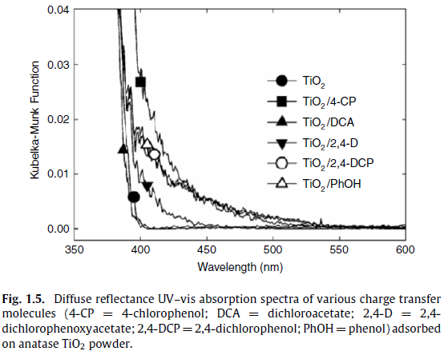
Fundamental issues associated with TiO₂ photocatalysis
1)、photon absorption step in a photocatalytic reaction is relevant to surfaces
  lattice truncation and surface dangling bonds
  ratio of ‘surface’ atoms to ‘bulk’ atoms
  Surface modification
  surface doping

Slide 5
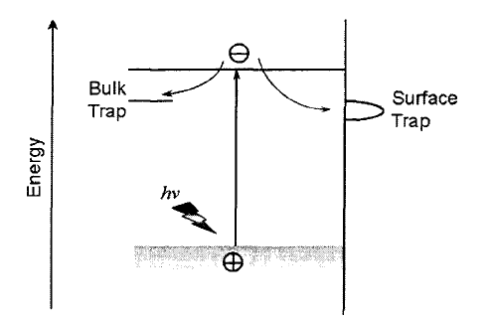
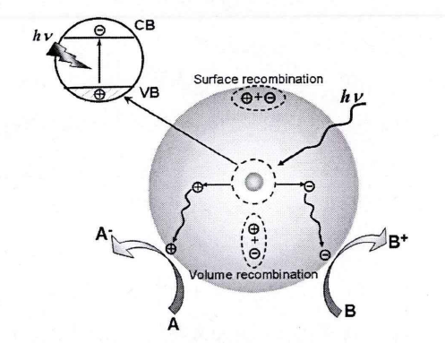
2)、Charge transport and transfer
  Excitation and charge carriers generation
  Generated charge carriers transport to the surface and be trapped
  Recombination of electron and hole
  Charge transfer between the surface and the chemisorbed (or physisorbed) species and redox reaction

Slide 6
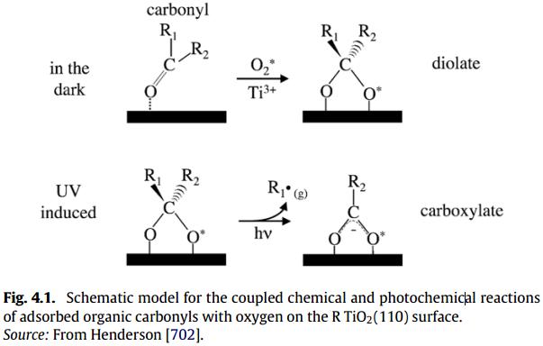
3）Adsorption and the adsorbed state
  physical and electronic structures
  Coverage, thermal stability and reactivity, adsorption structure and site, etc
  structure sensitivity and coverage dependence

Slide 7
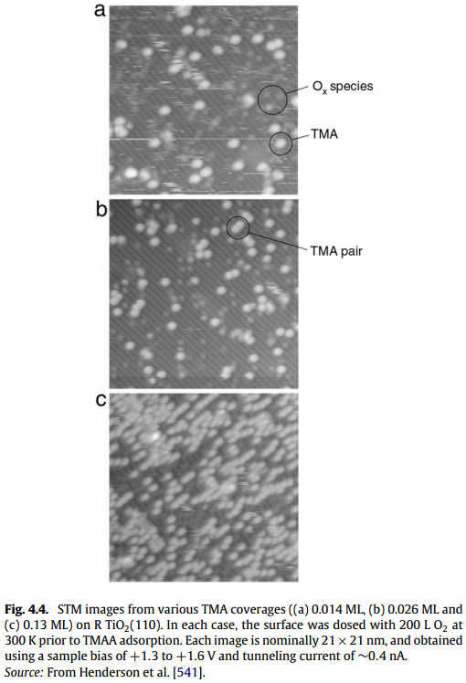
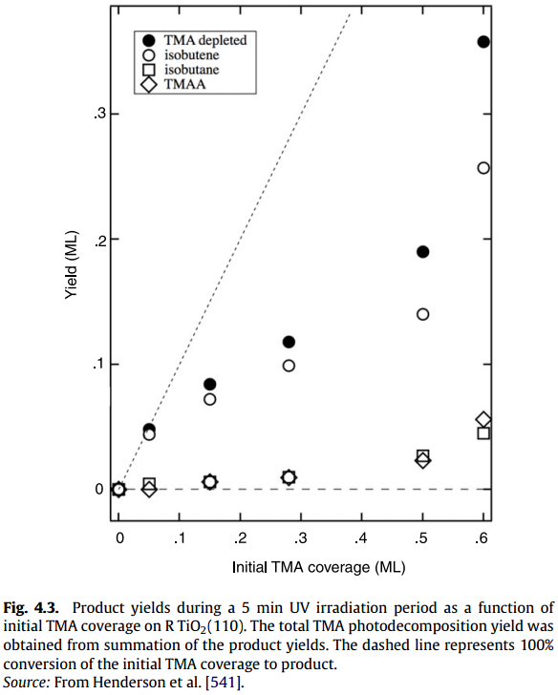
Coverage dependence
  Trimethyl acetate (TMA)

Slide 8
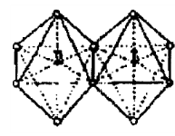
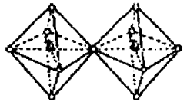
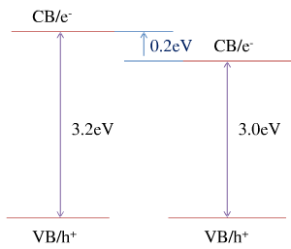
Phase
Anatase(A)
Rutile(R)
Mixed-phase(A and R)
A R
Mixed-phase TiO₂ photocatalysts show interesting photocatalytic properties not seen in either single phase
A R

Slide 9
Particle surfaces
  Particle shape：spheres, tubes, rods, cubes, sheets, polyhedrals and more
  Particle size: Changes in particle size influence photoactivity through changes in surface area, light scattering and light absorptivity
  Particle suspensions: remove the role of particle–particle interfaces, grain boundary charge trapping and recombination,

Slide 10
Performance improvement
efficiencies
optical absorption
photogenerated charge separation
carrier-induced surface reaction

Slide 11
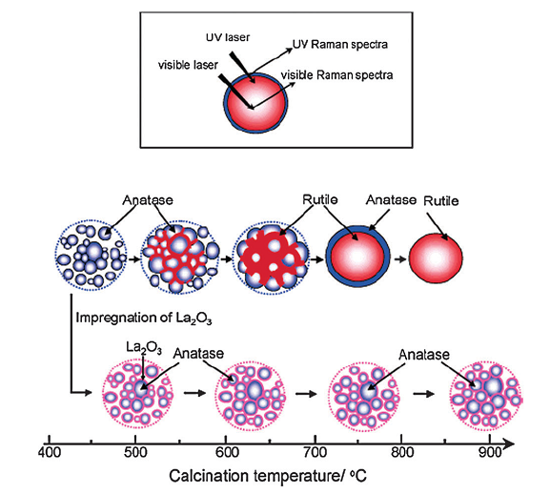
Enhance nano-sized TiO₂ surface structures and surface properties
Surface binding for high thermal stability of TiO₂
a)Oxide binding
Stabilize anatase TiO₂ and improve its photocatalytic activity

Slide 12
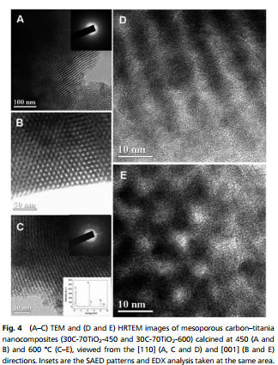
b)Carbon binding
The thin carbon layer act as a barrier to avoid their direct contact, inhibiting crystal growth and anatase-to-rutile phase transformation. the electronic contacts between semiconductor and carbon layer could contribute to an eﬀective separation of electron–hole pairs.

Slide 13
c)Inorganic acid anion binding
Surface binding with inorganic non-metal anions such as F⁻,PO₄³⁻ and SO₄²⁻ ions,which can produce the negative electrostatic field formed in the surface layers of TiO₂ after modification with the inorganic acids would be favourable for the separation of photogenerated charges.

Slide 14
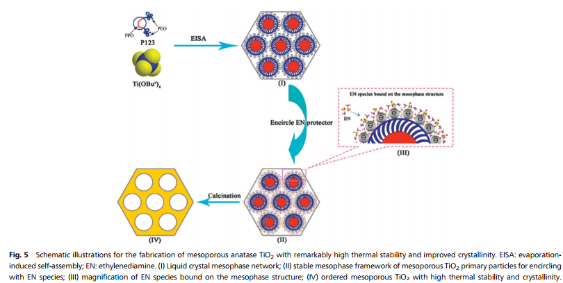
d）Amine and ammonia surface binding
EN can readily bind to surfaces of mesoporous TiO₂ primary particles with negative charges in the reflux process, leading to the formation of well-defined and stable mesostructured hybrids.

Slide 15
2)Surface induction for hierarchical structure assembly
The synergetic eﬀects of diﬀerent dimensional levels, high surface-to-volume ratios and permeability. Hydrothermal and solvothermal methods→creating hierarchical structures because of the control over the particle size, shape, crystal structure and other parameters. the surface of the building units is first modified in the solution; subsequent self-assembly, or ‘‘growth-then-assembly” process could then induce the formation of hierarchical micro-nanostructures.
a )TiO₂
b)ZnO

Slide 16
3) Surface deposition for heterojunctional nanocomposites
Heterojunctional composites with multiple integrated functional components could combine the advantages of diﬀerent components to overcome some drawbacks of single-component photocatalysts
  improved separation eﬃciency of photogenerated electrons and holes,
  enhanced light absorption including UV and visible light,
  increased stability

Slide 17
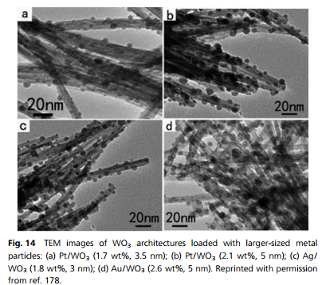
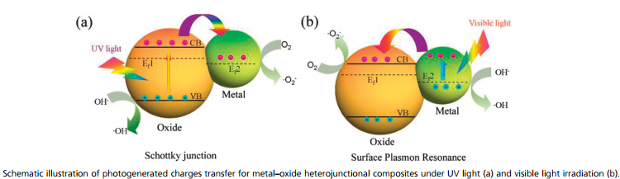
a)Metal–oxide heterojunctional composites
The metals play important roles on improving the photocatalytic performance in metal–semiconductor oxide heterojunctional composites. The formation of a Schottky barrier via Fermi level equilibration between metals and semiconductor oxides, and the surface plasmon resonance (SPR) effects are the obvious benefits.

Slide 18
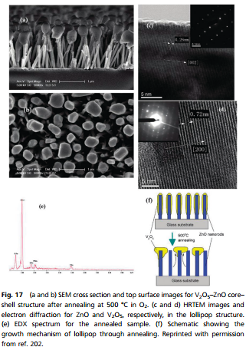
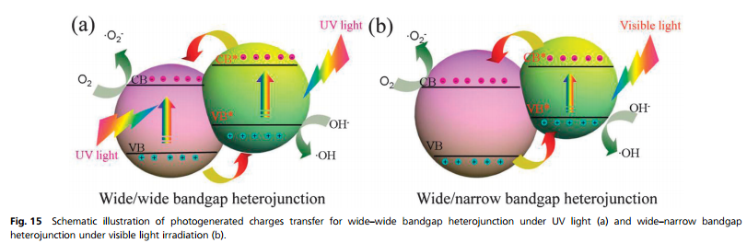
b)Semiconductor–oxide heterojunctional composites
The interface of two different semiconductors with different band levels could form a built-in potential easily, such as p–n junctions, which can promote the separation and transportation of photogenerated electron–hole pairs. The band offset can efficiently promote the charge separation, and inhibit the charge recombination, and thus enhance the photocatalytic performance

Slide 19
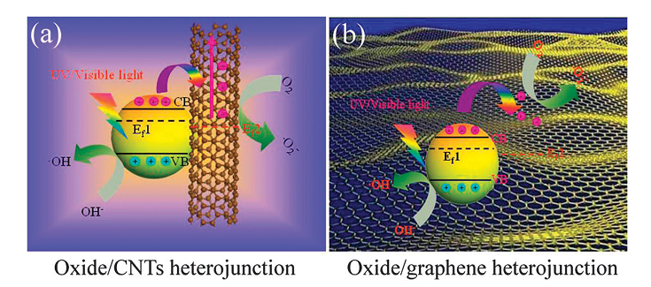
c)Oxide–carbon heterojunctional composites
enhanced charge separation and transfer efficiency due to the formation of the
heterojunction,
(2) extension of light absorption to the visible light region,
(3) increased absorption of reactants and products due to the large surface area.

Slide 20
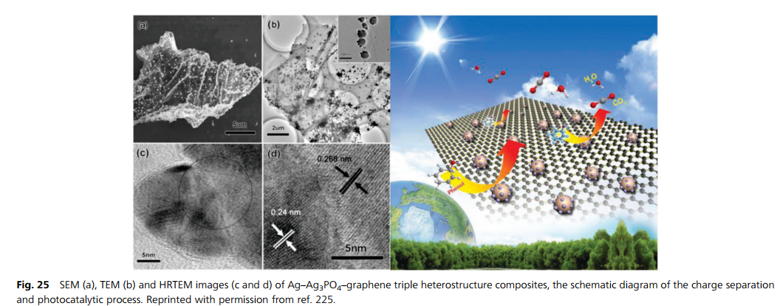
d)Multi-component oxide-based heterojunctional composites
Multiple functional components could offer more benefits for promoting the separation of photogenerated electron–hole pairs and extending the light absorption range, and also other additional properties.

Slide 21
4)Surface modification for high-energy-facet exposure
Photocatalytic reactions mainly take place on the surfaces of semiconductor oxides, nanoparticle surface structure would play critical roles in photocatalysis, especially for exposed high-energy crystal facets.

Slide 22
Application
Photocatalyst
TiO₂
NO_{x} decomposition
Deodorization
Water treatment
Anti –bacteria
Dirtiness prevention

Slide 23

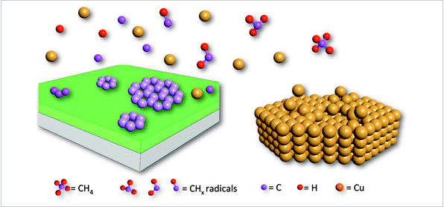
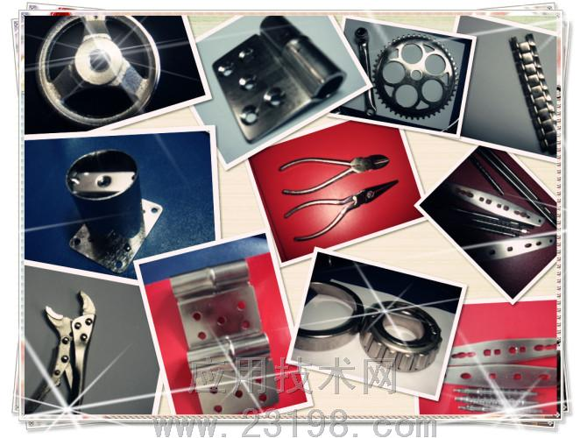

Cosmetology
Growth graphene
Environmental conservation
Resource translation
Surface preparation
Stealth material

Slide 24
Pacific Northwest National Laboratory
Stanford University
Dongyuan Zhao
Xueming Yang

Slide 25
Thanks

